Slide 1
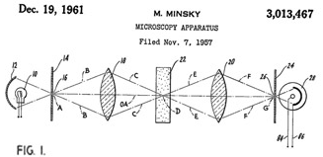
Confocal Microscopy
Kurt Thorn
NIC

Slide 2
Optical Sectioning and 3D reconstruction
z
x
y

Slide 3
Optical Sectioning and 3D reconstruction
z
x
y

Slide 4
Optical Sectioning and 3D reconstruction
=
z
x
y

Slide 5

Optical Sectioning and 3D reconstruction
C. elegans with two different sensory neurons expressing GFP, DsRed
Swept-Field Confocal, 85 Z slices, 250 nm spacing

Slide 6
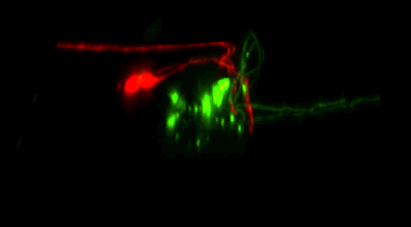
Optical Sectioning and 3D reconstruction
3D reconstruction

Slide 7
Fluorescence Illumination of a single point
Camera
Tube lens
Excitation light
Emission light
Objective lens
Sample
Problem – fluorescence is emitted along entire illuminated cone, not just at focus

Slide 8
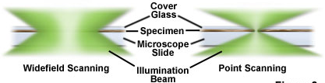
Widefield fluorescence imaging
Widefield Illumination
Point Illumination

Slide 9
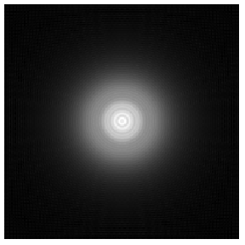
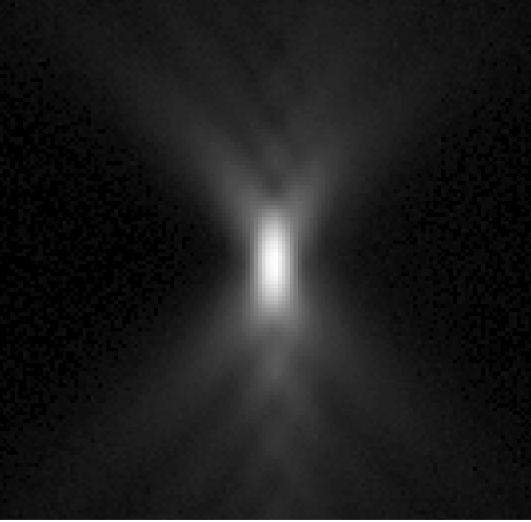
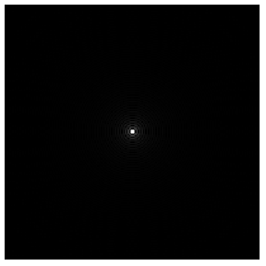
The Point Spread Function (PSF)
The image of a point object
2D PSF
for different defocus
Z=+2µm
3D PSF
Calculated
Measured
z
Z=0
Z=-2µm
y
x
x

Slide 11
The confocal microscope
Scan excitation spot point-by-point to build up image
Detector
Pinhole
Tube lens
Excitation light
Emission light
Objective lens
Sample

Slide 12
How big should your pinhole be?
Resolution is limited by the point-spread function
Y
X
Airy disk radius
≈ 0.61 λ /NA
Z

Slide 13
How big should your pinhole be?
Want pinhole to pass entire Airy disk
Y
X
Airy disk diameter
≈ 1.22 λ /NA
Width of point spread function at pinhole: Airy disk diameter × magnification of lens

Slide 14
How big should your pinhole be?
Width of point spread function at pinhole = Airy disk diameter × magnification of lens = 1 Airy unit = resolution of lens × magnification of lens × 2
100x / 1.4 NA: resolution = 220nm, so 1 Airy unit = 44 μm
40x / 1.3 NA: resolution = 235nm, so 1 Airy unit = 19 μm
20x / 0.75 NA: resolution = 407nm, so 1 Airy unit = 16 μm
10x / 0.45 NA: resolution = 678nm, so 1 Airy unit = 14 μm

Slide 15
Pinhole size
C1si: 30, 60, 100, 150 μm
Spinning Disk: 50 μm
All are substantially larger than Airy Disk for low magnification lenses.
On spinning disk, can use 1.5x magnification changer

Slide 16
Light sources
Excitation light must be focused to a diffraction limited spot
Could be done with an arc lamp and pinhole – but very inefficient
Excitation light
Enter the laser:
Perfectly collimated and high power
Objective lens
Sample

Slide 17
Scanning
Changing entrance angle of illumination moves illumination spot on sample
Objective lens
The emission spot moves, so we have to make sure pinhole is coincident with it
Sample

Slide 18
Confocal optical path
Dichroic
Pinhole
Scanning mirrors
x
Detector
y
Laser
Relay lens
Objective

Slide 19
C1si internals

Slide 20
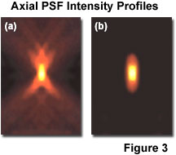
What do you get?

Slide 21
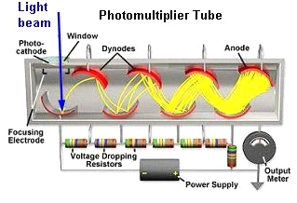
Detectors - PMTs
Must be fast – confocal beam spends only a few μs on each pixel
Photomultiplier tubes
Pulse width for single photon ~ 10-100ns
Very linear
Very high gain
~ 0 read noise

Slide 22
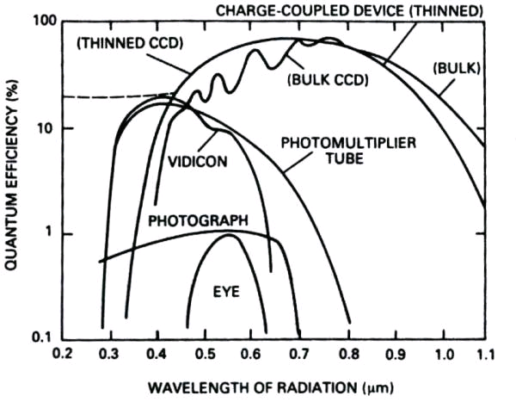
Detectors - PMTs

Slide 23
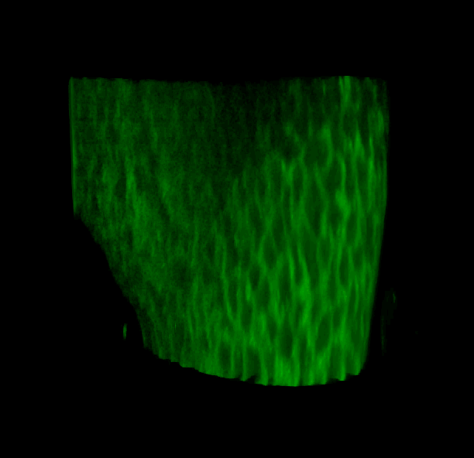
Laser-Scanning Confocal
E11.5 mouse lung stained for E-cadherin
Nan Tang, Martin lab

Slide 24
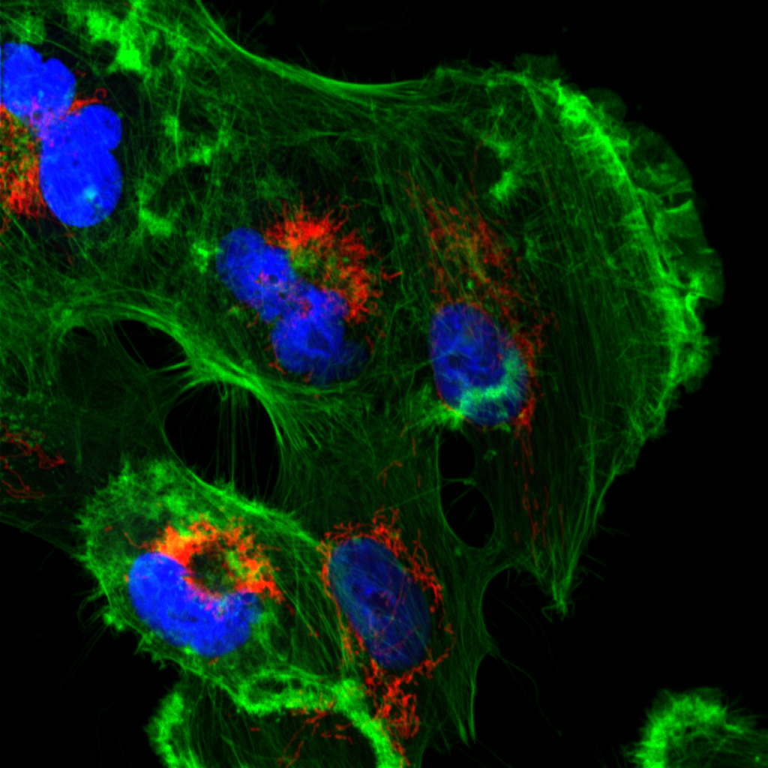
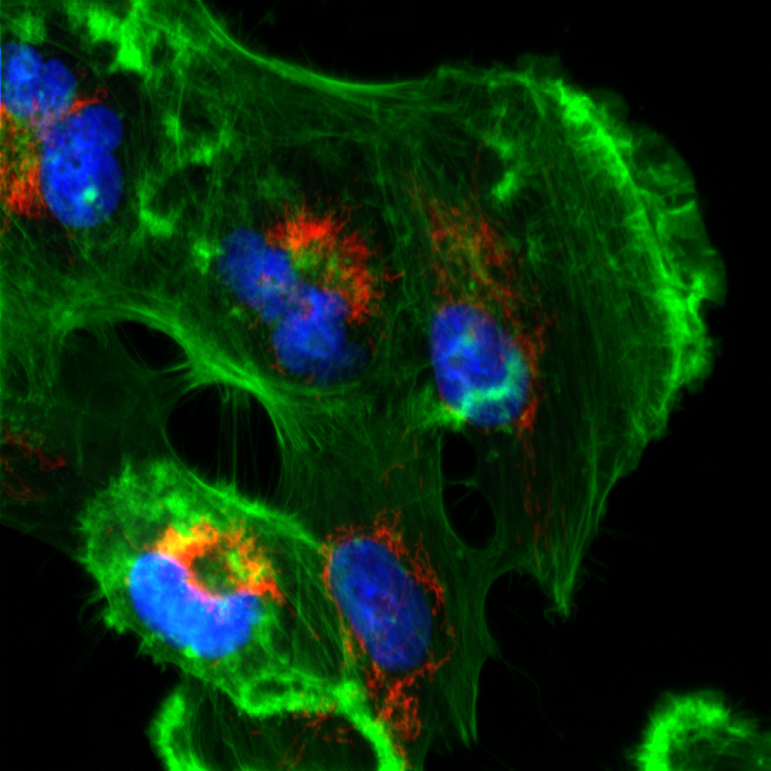
Confocal vs. Widefield
Confocal
Widefield
Tissue culture cell with 60x / 1.4NA objective

Slide 25
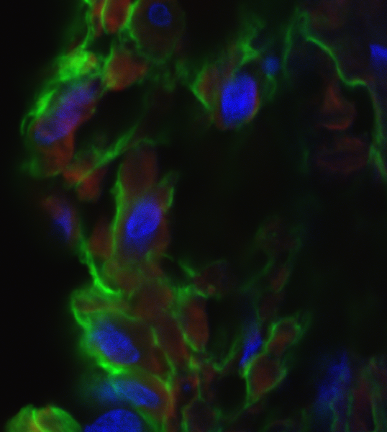
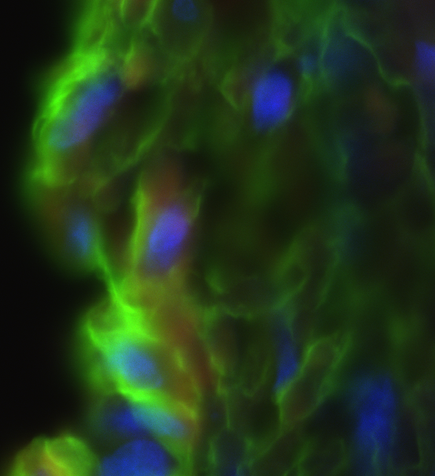
Confocal vs. Widefield
Confocal
Widefield
20 μm rat intestine section recorded with 60x / 1.4NA objective

Slide 26
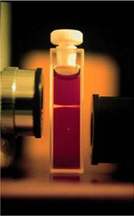
Multi-photon excitation
Internal
conversion
S₁
hν_{A}
hν_{A}
hν_{E}
hν_{A}
S₀
2
1
0
Brad Amos, MRC, Cambridge
Multi-photon excitation does not excite out-of-focus light, so you can get rid of pinhole

Slide 27
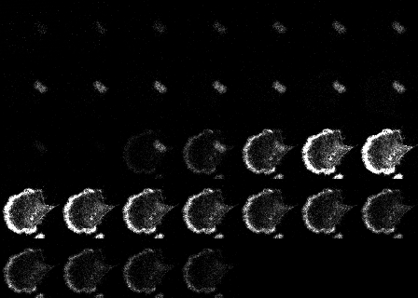
Spectral Detection
Montage of 32 channels of sample stained with DAPI and Alexa 488

Slide 28
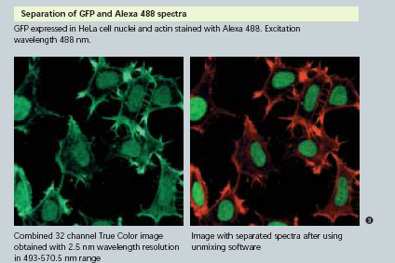
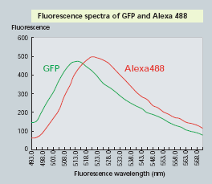
Spectral Confocal

Slide 29
Autofluorescence removal
Drosophila embryo with neuronal GFP staining – Jan lab
Best single channel image
After autofluorescence removal by linear unmixing

Slide 30
The confocal microscope
Scan excitation spot point-by-point to build up image
Problems:
Slow (~1 sec to acquire an image)
Low light efficiency (due to use of PMT as detector)
Solution:
Use multiple pinholes and a camera
Detector
Pinhole
Tube lens
Excitation light
Emission light
Objective lens
Sample

Slide 31
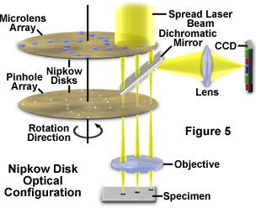
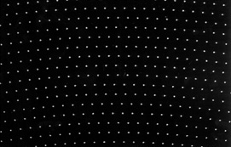
A Solution: Spinning Disk Confocal
Image with many pinholes at once, so fast
Use CCD as detector, so much higher QE

Slide 32
Pros/Cons of spinning disk
Fast – multiple points are illuminated at once
Photon efficient – high QE of CCD
Gentler on live samples – usually lower laser power
Fixed pinhole – except in swept-field
Small field of view (usually)
Crosstalk through adjacent pinholes limits sample thickness

Slide 33
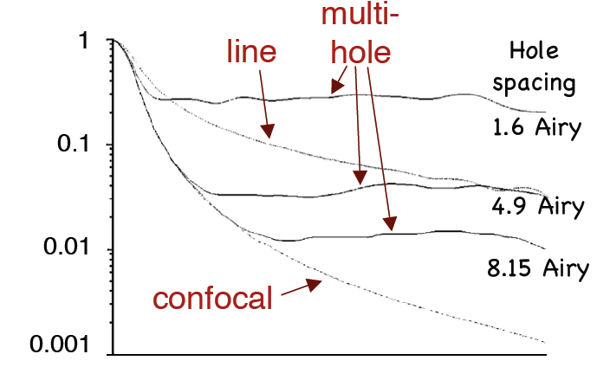
Out-of-focus rejection
T
Defocus
Wolleschensky et al. J. Biomed. Opt. 11(6) 2006

Slide 34
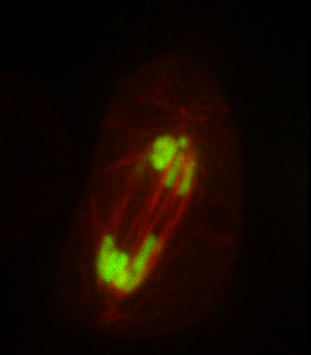
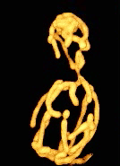
Examples
Drosophila S2 cell expressing GFP-H2B and mCherry-tubulin (Nico Stuurman and Ron Vale)
S. cerevisiae expressing a mitochondrially targeted RFP, Susanne Rafelski, Marshall lab

Slide 35
Which imaging technique should I use?
1-5 μm
TIRF (for samples at the coverslip)
Wide-field (+deconvolution)
1-20 μm
Fast
Spinning Disk Confocal
Sample Thickness
Sensitivity
10-100 μm
Line-scanning confocal
>20 μm
Point scanning Confocal
Slow
>50-100 μm
2-photon confocal

Slide 36
When to use confocal?
Confocal is not a magic bullet
It is extremely wasteful of photons
Laser-scanning confocal is 100 – 200-fold less sensitive than widefield
Spinning-disk confocal is ~4-fold less sensitive than widefield

Slide 37
When to use confocal?
Confocal is not a magic bullet
It is extremely wasteful of photons
High laser power generally result in more photobleaching and photodamage.
For thin specimens, widefield epifluorescence is better – especially with deconvolution
Confocal excels with thick, heavily stained specimens

Slide 38
When to use confocal?
What is thick?
A good rule of thumb is 10 × the depth of field of the objective
100x / 1.4 NA: d.o.f. 0.66μm
20x / 0.75 NA: d.o.f 2.3 μm
Sample preparation is KEY for imaging thick specimens
Confocal does not fix scattering, refractive index mismatch, or everything else that can go wrong – it only removes out of focus light

Slide 39
Sample preparation
For fixed samples: match refractive index of mounting media to immersion oil.
Mount in immersion oil itself, BABB, benzyl alcohol/glycerol, 2,2’-thiodiethanol, or other high-RI mounting medium
Clearing to remove lipids and other scattering substances is also important
For live samples, use water immersion lenses

Slide 40
Spherical Aberration
Point spread functions
Ideal
1 wave of spherical ab
z
x
x

Slide 41
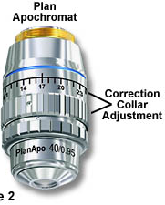
Sources of Spherical Aberration
Design compromises
Manufacturing tolerances
Immersion fluid index error
Temperature variation
Cover slip thickness
(high-NA objectives except oil immersion)
Correction collar setting
Sample refractive index mismatch

Slide 42
Index Mismatch
& Spherical Aberration
objective
n₁
Immersion
fluid
Cover glass
n₂
Sample
Focus at cover slip
Focus
into sample
Spherical aberration
unless n₂ = n₁

Slide 43
Index Mismatch
& Spherical Aberration
z=0 µm
n₁=1.515 (oil)
z=25 µm
n₂=1.44
(Vectashield)
z=50 µm

Slide 44
Index Mismatch
& Axial Scaling
n₁
Optical
focus
step δz_{o}
n₂
Mechanical
focus
step δz_{m}
If there is index mismatch,
your z pixel size is not what you think

Slide 45
Getting Rid of Spherical Aberration
Use correct and consistent cover slips
Pick a room with stable temperature ≈ 20°C
Adjust correction collar
If no collar, adjust immersion medium index
Use an objective that is matched
to the mounting medium:
For aqueous samples, use a
water immersion objective
For fixed samples viewed with
oil immersion objectives, ideally use a
mounting medium with index ≈ 1.515
For fixed samples in commercial media,
ideally use a glycerol immersion objective

Slide 46
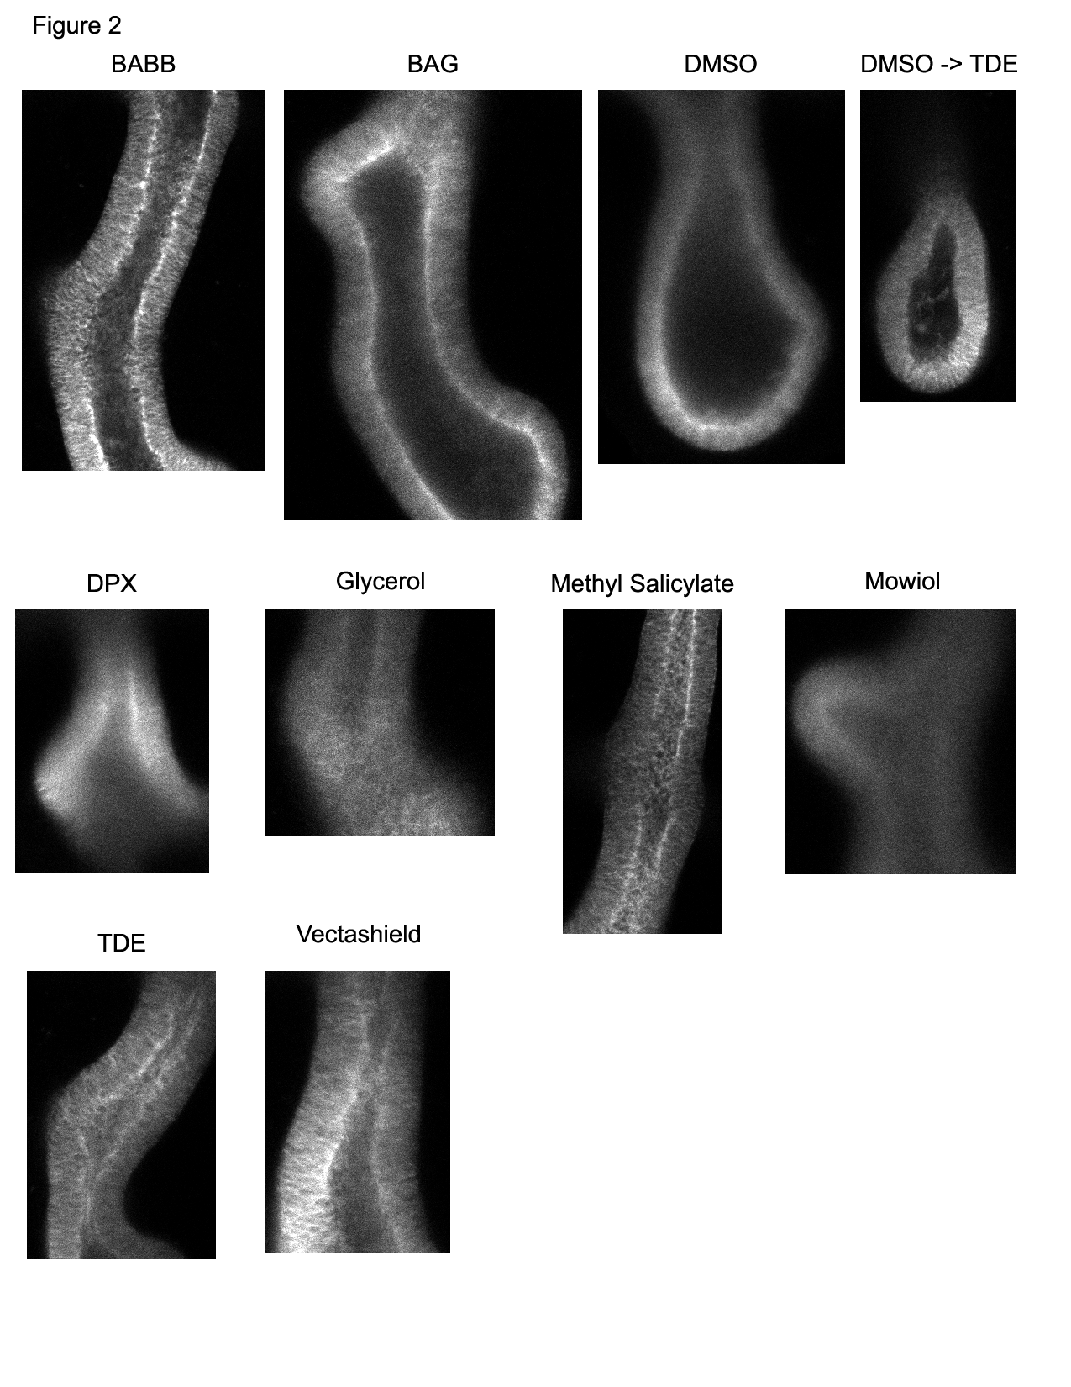
Sample Preparation
Samples imaged with 20x / 0.75 air objective on spectral confocal
Sections acquired ~ 50 μm into tissue
Embryonic mouse lungs; samples from Nan Tang, Martin Lab

Slide 47
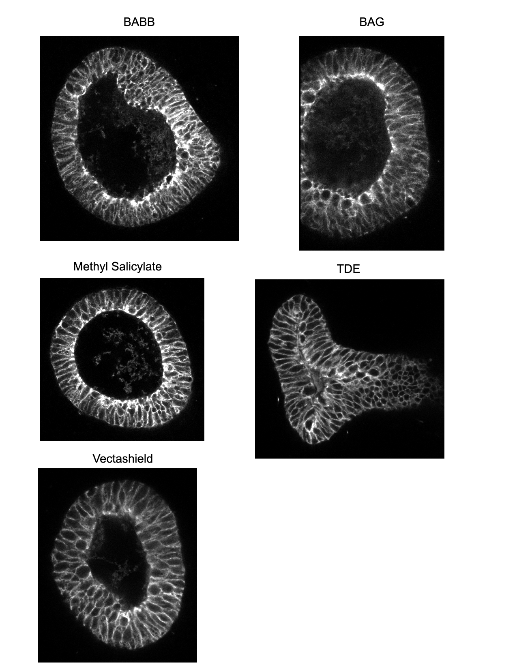
Sample Preparation
Samples imaged with 40x / 1.3 oil objective on spectral confocal
Sections acquired ~ 50 μm into tissue
Embryonic mouse lungs; samples from Nan Tang, Martin Lab

Slide 48
Clearing and mounting summary
Both clearing and refractive index matching are important.
BABB and methyl salicylate clear very well and give best image depth, but may disrupt cell morphology
TDE preserves cell morphology and also allows for decent imaging depth

Slide 49
Resources
Slides can be downloaded from:
http://nic.ucsf.edu/dokuwiki/doku.php?id=presentations
http://www.microscopyu.com
http://micro.magnet.fsu.edu
James Pawley, Ed. “Handbook of Biological Confocal Microscopy, 3rd ed.”
Murray JM et al., J. Microsc. 2007, 228: p.390-405
Acknowledgements
Steve Ross, Mats Gustafsson

